Slide 1
Introduction to Eureka Discovery Service

Slide 2
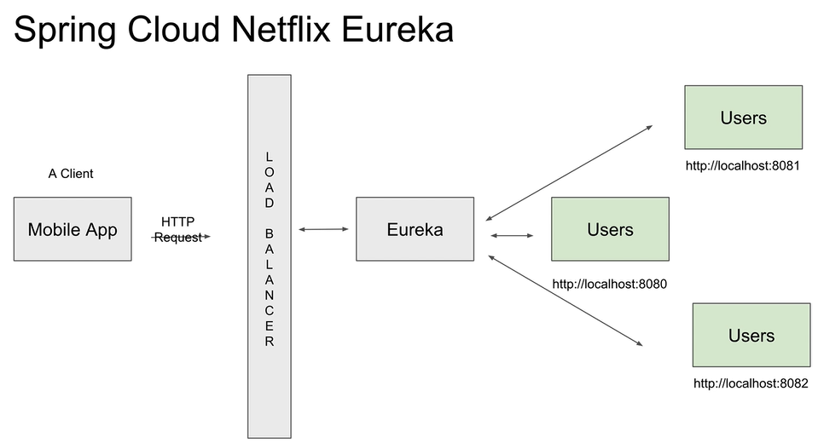

Slide 3
Startup Eureka Service Discovery…

Slide 4
